Slide 1
DATA STRUCTURES
STACKS

Slide 2
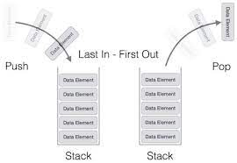
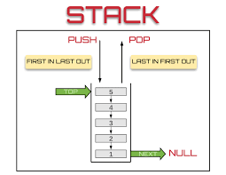
What is a Stack?
Stacks in Data Structures is a linear type of data structure that follows the LIFO (Last-In-First-Out) principle and allows insertion and deletion operations from one end of the stack data structure, that is top.

Slide 3
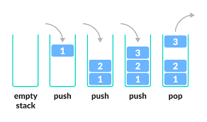
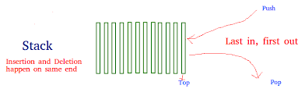
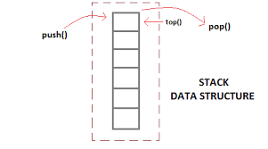
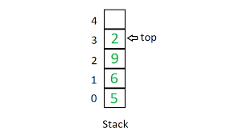
Stack

Slide 4
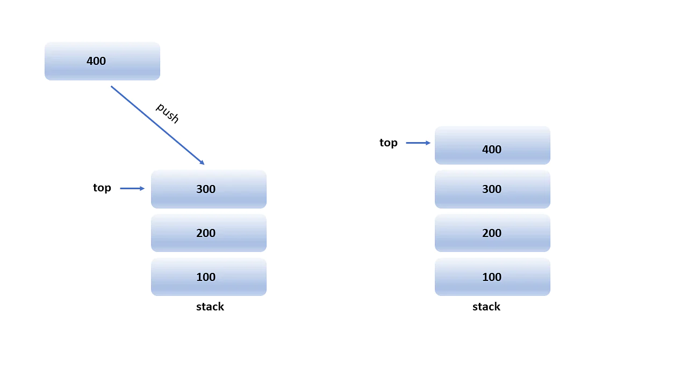
Operations On Stack
Push Operation
Push operation involves inserting new elements in the stack. Since you have only one end to insert a unique element on top of the stack, it inserts the new element at the top of the stack

Slide 5
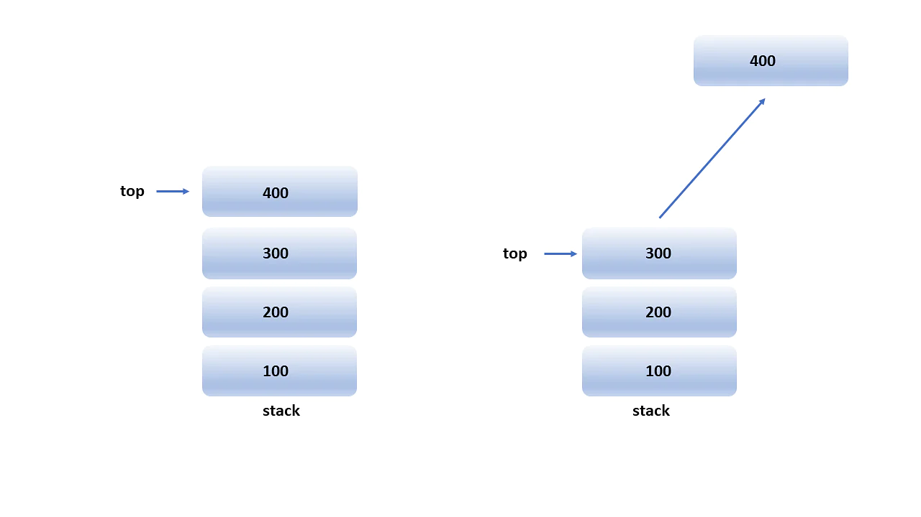
Operations On Stack
Pop Operation
Pop operation refers to removing the element from the stack again since you have only one end to do all top of the stack. So removing an element from the top of the stack is termed pop operation.

Slide 6
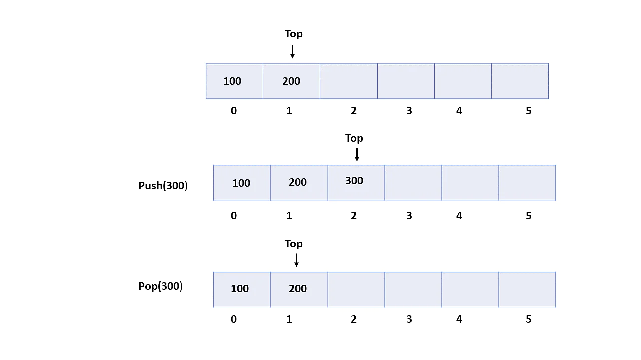
Implementation Of Stack
Array:
In array implementation, the stack is formed using an array. All the operations are performed using arrays. You will see how all operations can be implemented on the stack in data structures using an array data structure.

Slide 7
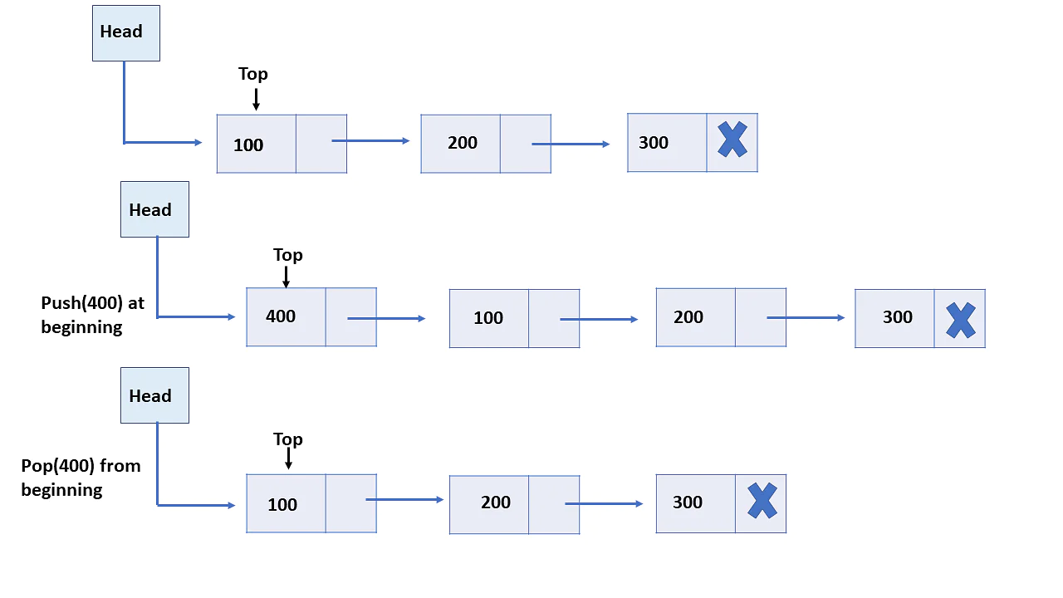
Implementation Of Stack
Linked-List:
Every new element is inserted as a top element in the linked list implementation of stacks in data structures. That means every newly inserted element is pointed to the top. Whenever you want to remove an element from the stack, remove the node indicated by the top, by moving the top to its previous node in the list.

Slide 8


